Slide 1
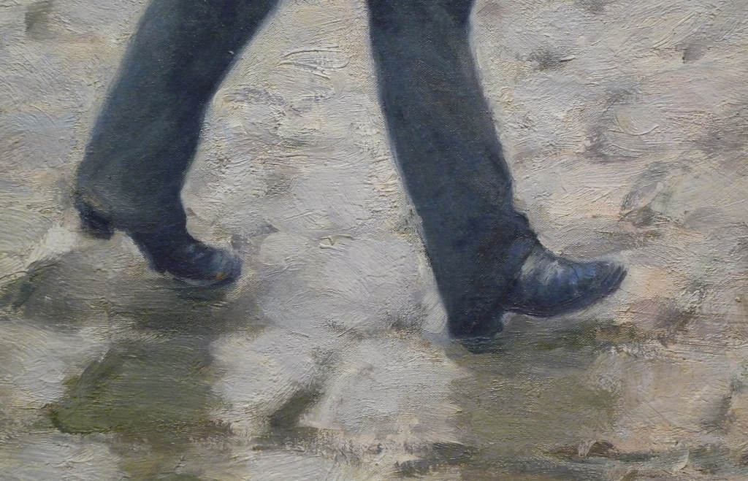
Human Gait Analysis & Recognition
Presenter: Rizwan Shah
Course: Pattern Recognition
Roll No: CSM24004

Slide 2
Intro to Human Gait Analysis
Gait analysis is the detailed study of how people walk, looking at how well they walk and any differences from normal walking patterns.
This technology is crucial in healthcare for diagnosing and treating medical conditions, in sports for improving performance, and in security for verifying identities.
This analysis uses various methods like video processing, machine learning, and sensor data evaluation to accurately recognize and understand how people walk.

Slide 3
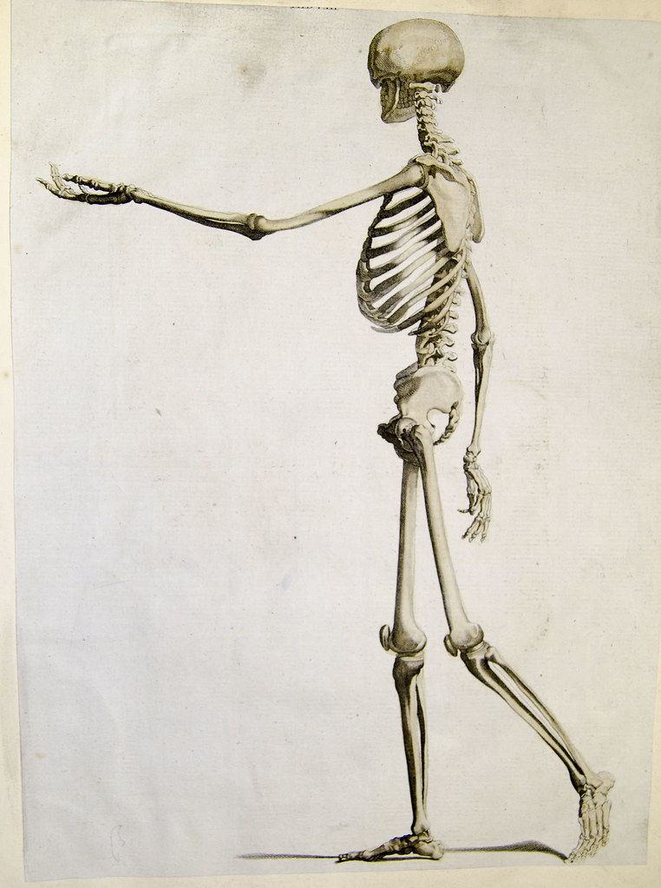
Understanding Human Gait
How Walking Works
Walking mechanics: Walking involves muscles and joints working together to move the body, using energy and absorbing shock.
Gait cycle phases: Walking has two main parts—stance (foot on the ground) and swing (foot in the air)—which vary by speed and surface.
Key measurements: Things like step length, walking speed, and forces on the ground help experts check if walking is normal or needs improvement.

Slide 4
Gait Analysis Techniques
Motion capture: 3D cameras monitor walking to gather precise movement information.
Wearable sensors: Compact devices track walking in real-time, wherever you are.
Video analysis: Software examines walking through videos recorded in clinics or outdoor settings.
AI algorithms: Advanced technology evaluates walking patterns for rapid insights.

Slide 5
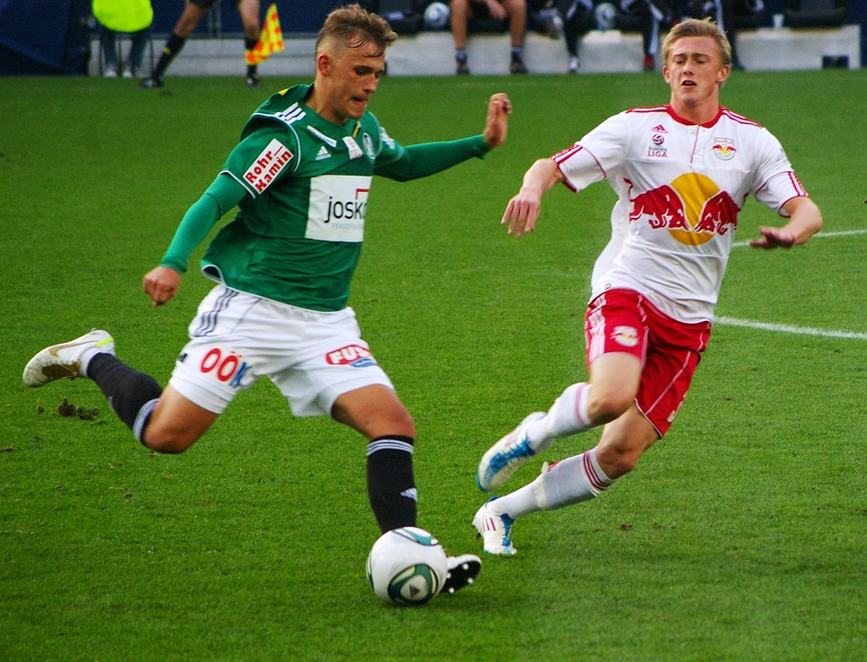

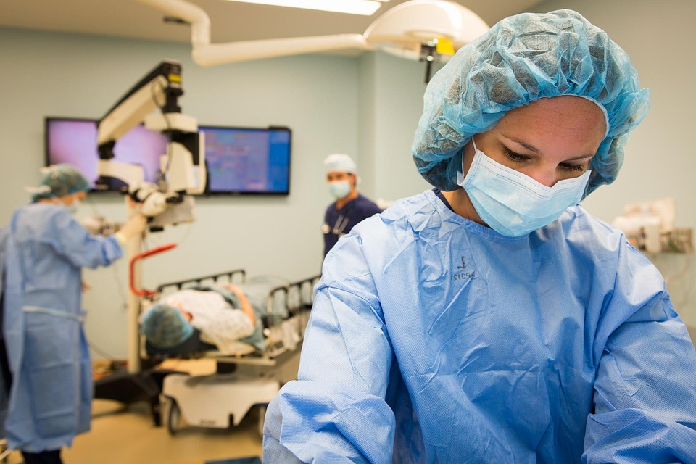
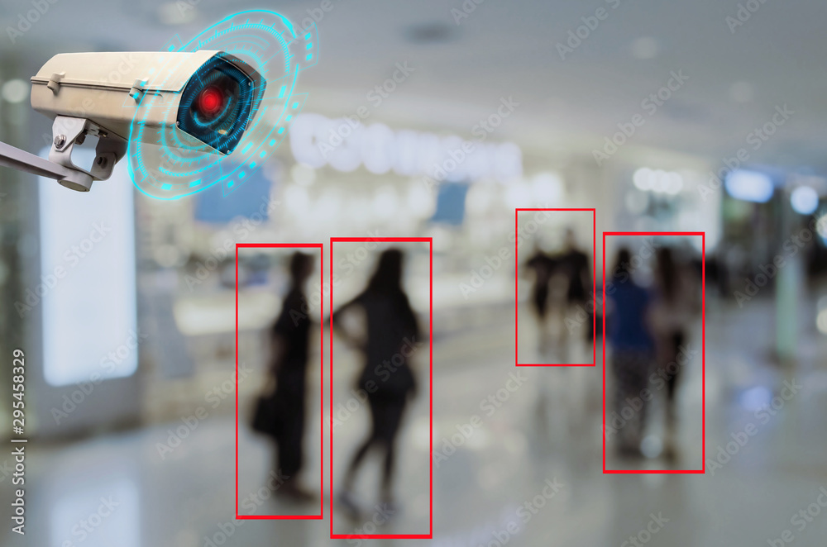
Applications of Gait Recognition
Healthcare: Aids in identifying issues, creating rehabilitation strategies, and tracking improvement.
Security: Identifies people based on their walking patterns.
Sports: Improves training effectiveness and lowers the chance of injuries by examining movement patterns.
Elder Care: Monitors walking to detect falls or health changes early.

Slide 6
Algorithms in Gait Recognition
Silhouette Shape: Uses body outlines from videos for unique gait patterns.
Temporal Alignment: Matches the timing of steps to identify walkers.
Static Parameters: Measures step length or width for a gait profile.
Convolutional Neural Networks (CNNs): Learns gait patterns from videos using AI.
Support Vector Machines (SVMs): Classifies walking styles with machine learning.
Gait Energy Image (GEI): Combines walking frames into one image for recognition.
Multi-Scale Feature Fusion (MFCF): Blends gait details for better accuracy.

Slide 7
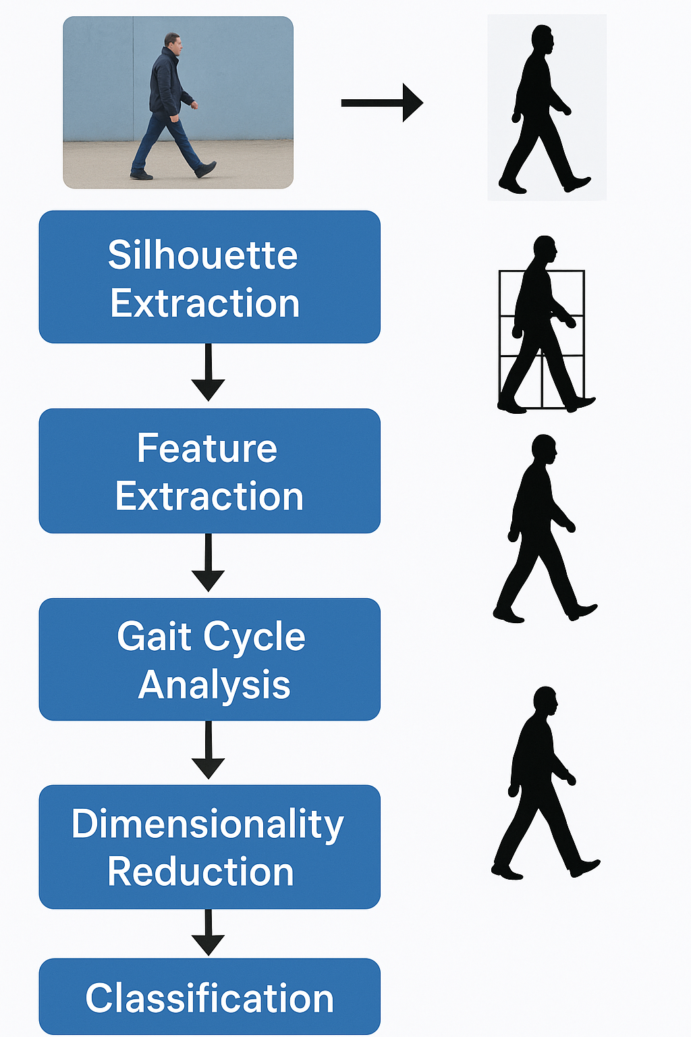
Silhouette Shape-Based Algorithms
Algorithms use the outline or shadow-like shape of a person's body, captured from video or images, to identify individuals based on their unique walking patterns.

Slide 8
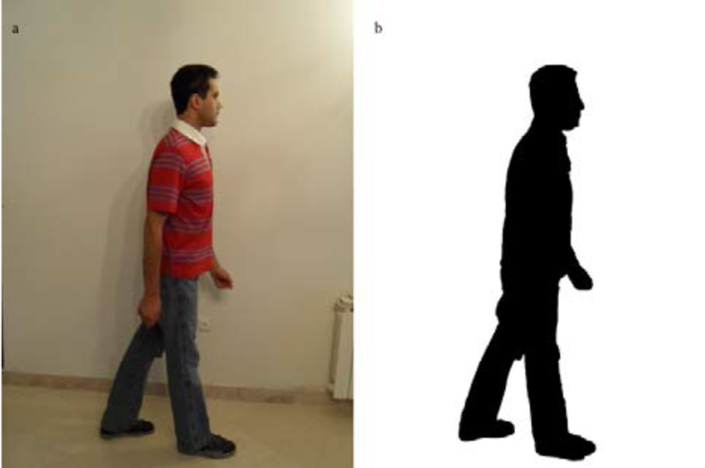
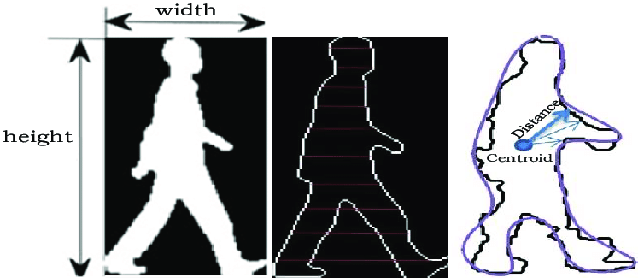
Silhouette Shape-Based Algorithms
Silhouette Extraction and Feature Extraction
Silhouette Extraction:
Uses background subtraction to isolate the moving figure from video frames.
Creates a shadow-like outline of the person.
Feature Extraction:
Measures key traits like width, area, and shape descriptors (e.g., Hu moments).
Captures unique characteristics of the silhouette for identification.

Slide 9
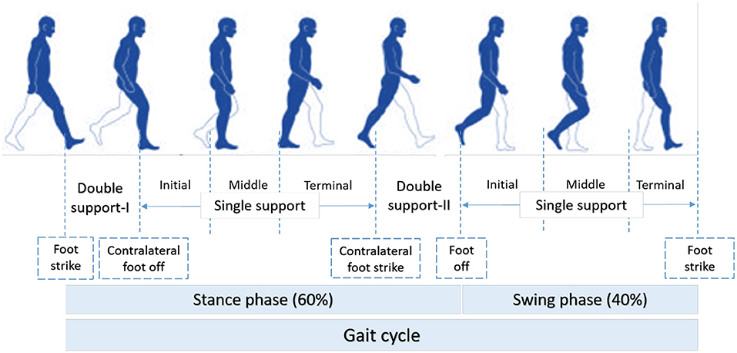
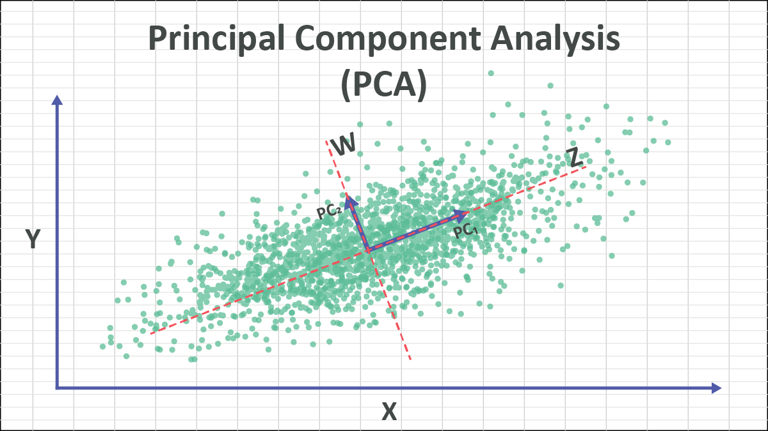
Silhouette Shape-Based Algorithms
Gait Cycle Analysis and Dimensionality Reduction
Gait Cycle Analysis:
Studies repeating walking phases (stance and swing).
Dimensionality Reduction:
Applies techniques like Principal Component Analysis (PCA).
Captures the dynamics of a person’s walking pattern.
Simplifies complex data while keeping essential information for recognition.

Slide 10
Silhouette Shape-Based Algorithms
Classification and Challenges
Classification:
Uses machine learning models (e.g. Support Vector Machines or neural networks).
Challenges and Limitations:
Clothing variations (e.g., loose attire) distort the silhouette.
Identifies individuals based on their unique gait features.
Background noise or clutter complicates silhouette extraction.
Changes in camera viewpoint alter the silhouette’s appearance.

Slide 11
Conclusion
The assessment and identification of human gait utilize cameras, sensors, and artificial intelligence to analyze and recognize individuals through their walking patterns. This innovative technology is beneficial in fields like healthcare diagnostics, security verification, and athletic training. Moreover, progress in AI, along with the incorporation of various sensors, helps overcome challenges related to loosen clothing and variations in camera perspectives.

Slide 12
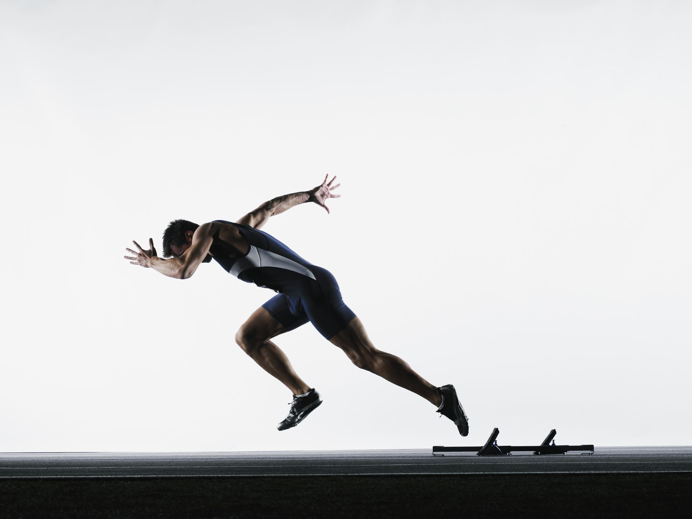
End

